Slide 1
Git Set Up and Command Lines

Slide 2
Git Set Up
Download Git for your operating system
https://git-scm.com/downloads
Check Git is available in your system :

Slide 3
Git Hub
GitHub is a code hosting platform for version control and collaboration. It lets you and others work together on projects from anywhere.
Steps to access GitHub:
1.Create a repository
2.Create A branch
(Branching is the way to work on different versions of a repository at one time.
By default your repository has one branch named master which is considered to be the definitive branch. We use branches to experiment and make edits before committing them to master.)
3.Do changes and Commit
4.Open Pull requests and Merge Pull requests
(Pull Requests are the heart of collaboration on GitHub. When you open a pull request, you’re proposing your changes and requesting that someone review and pull in your contribution and merge them into their branch. Pull requests show diffs, or differences, of the content from both branches. The changes, additions, and subtractions are shown in green and red.)

Slide 4
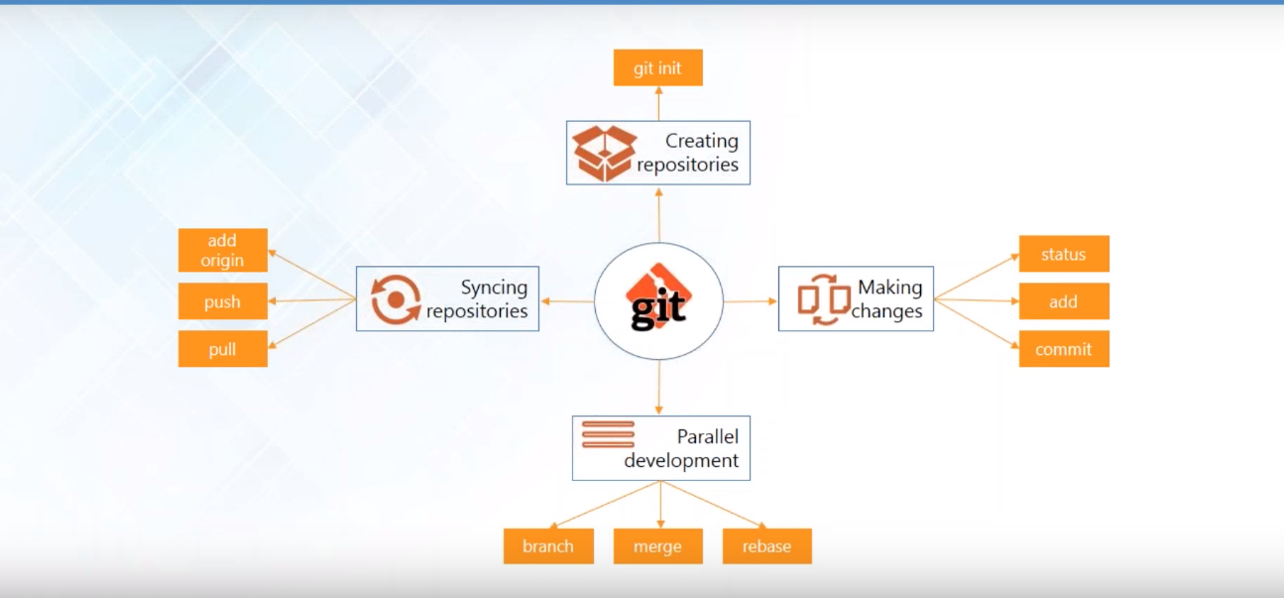
Git Commands with Work Flow

Slide 5
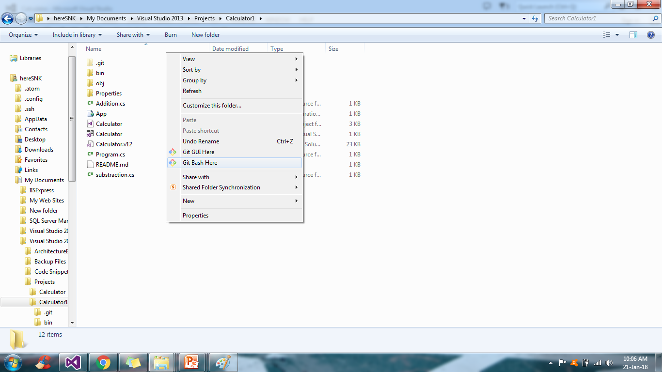
Creating Local Repository - git init

Slide 6
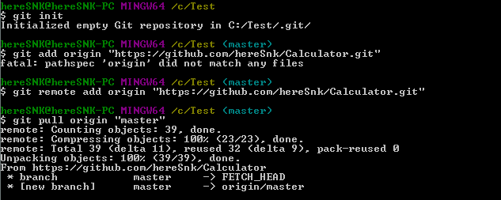
Synch Git Local to GitHub
1. git remote add origin “repository link”
2.git pull origin “branch_name”

Slide 7
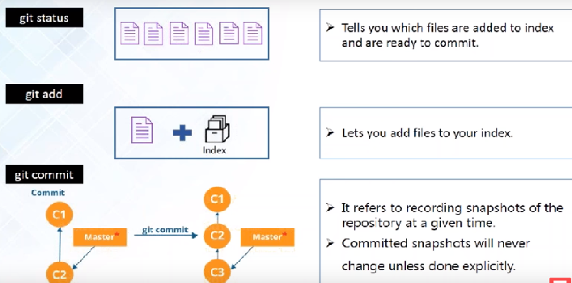
Making Changes
git add –A >>>>to add all file together in index
git commit –a –m “message” to commit all file together

Slide 8
Branching
In one sentence Branching is specification of commits
Creating branch:
git branch “new branch name”
Switching From one branh to another:
git checkout “branch_name want to work on”

Slide 9
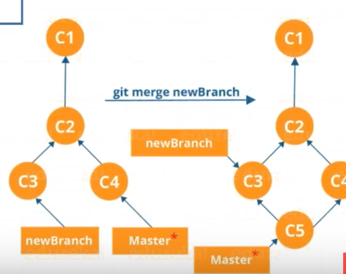
Merging
Combining the work of different branches together
git merge “from where we are merging code in main branch”

Slide 10
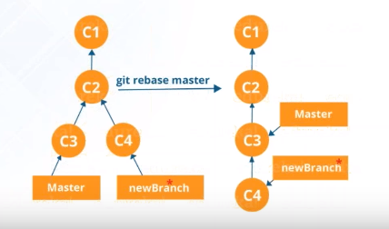

Rebasing
This is also a way of combining the work together but it is for linear sequence of commits.

Slide 11
Push all Changes to Remote Repository
Steps:
Switch to GitHub click on “Clone or Download” and Click on “use ssh” , Keep the link
In order to connect with that ssh link need to create ssh key using command in git bash “ssh-keygen”
Get ur ssh key from C drive
Switch back to GitHub and render to personal settings and click on “New SSH key”
Copy your generated key and add it
Come to git bash use command “ssh –T ssh link”
Use command “git push origin “branch name” “

Slide 12
Few more terminologies:
Licensing a repository: Public repositories on GitHub are often used to share open source software. For your repository to truly be open source, you'll need to license it so that others are free to use, change, and distribute the software. There is one website called choosealicense.com which will help us to understand what type of license we should have for our code
Fork: A fork is a copy of a repository. Forking a repository allows you to freely experiment with changes without affecting the original project. Most commonly, forks are used to either propose changes to someone else's project or to use someone else's project as a starting point for your own idea
Pull request:Create a pull request to propose and collaborate on changes to a repository.

